Slide 1



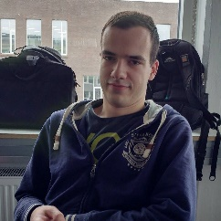
Project EAL Campus Operation project rooms
Team Hillary
Roxana Ion
Hedviga Arta Geriņa
Jonas Laursen
Marius Šibajevas
Notes:
Our Team:
Roxana Ion, Hedviga Gerina, Marius Sibajevas, & Jonas Laursen
[Introduce ourselves]
Team Hillary

Slide 2
Problem description
Rooms are always reserved
Reserved rooms are not always used
Affects almost all students
Annoyance for almost all students
Notes:
The problem we have decided to tackle, is the fact that all project rooms always seem to be reserved.
When we started to investigate the issue, we found that many rooms where reserved, but not actually being used.
We feel this issue should be solved, because it affects, and is an annoyance to lots of students, who needs these rooms to work efficiently.

Slide 3
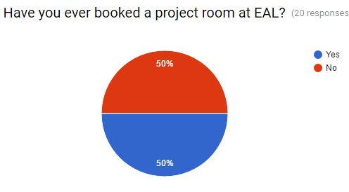
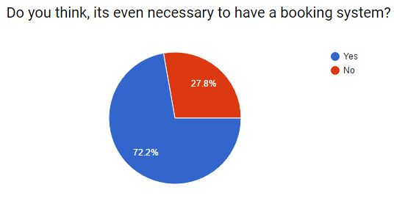
Survey
Survey was used to collect:
Responses on particular answers
Feedback on existing system
Extra comments
Ideas from students
Notes:
We decided to make a survey to figure out what students really think about project room booking system.
We asked them some basic questions about booking a room and inconveniences when doing it.
Then we asked if they think it is necessary to have a booking system at all and if they had booked a room and didn't really used it.
Participants of the survey were also free to leave their comments and ideas for solutions.
The results have shown that a significant part of the students who didn't book a room just don't know how to do it. And those who tried to book a room often faced a problem, that all the rooms were booked already. We also found out, that those who actually booked a room and didn't need it for some reason just didn't bother to cancel the reservation and this is the main problem to solve.
Based on results of the survey we developed several possible solutions, so that we could pick the best one later.

Slide 4

Experiments
Different Interfaces
Removing Booking System
Charging people
Notes:
If we had more time, we would like to conduct a series of experiments, to give us more insight into how exactly rooms are being used, and help us find ways to solve the issue.
We have worked out 3 experiments to test different aspects.
Interface:
Using different interfaces, instead of emailing the reception, make an app that allows student to book and cancel rooms from their phone.
Working Practice
Removing the booking system all together
Business Process
Starting to charge people to use the rooms
For the first experiment, the variables would be different types of interfaces, like a map, list, or cli.
The second experiment only has one variable, the system itself, being removed.
The 3rd experiment we can try different price’s.
To collect results about the experiments we would make a questionnaire, which would aim to gather data around
Satisfaction with the booking system (or lack there off)
Ease of use
And we would walk around, noting down what people where using the rooms for.

Slide 5

Ideas
Notification/Confirmation.
Book on monitors outside the rooms.
Lock rooms.
Removing any booking system.
Reminders on monitors by the doors.
Pay for using rooms.
More project rooms.
Limited hours.
Punishments, shame list, rewards.
Remove project rooms. Kill the entire human race, shutdown the school, stuff like that.
Notes:
Notification/Confirmation on if you still want room.
+People will remember.
-Could be annoying.
Book rooms on the monitors outside the rooms.
+Have to put effort and go to room to book it.
-Have to put effort and go to room to book it.
Actually lock rooms to those who book it.
-No one can get in.
+Might be reason why people will not forget to cancel the rooms if not needed.
Removing any booking system.
-No order.
-Might not solve the problem.
+Might solve the problem.
Put reminders to cancel reservation, if finish early, on monitors by the doors
+People will remember.
-Can be not noticed.
-Can be easily ignored.
Make people pay for using rooms.
-A lot unhappy student.
-Rooms might not be used anymore.
+Will use the rooms only when needed.
+Gets some extra money.
Make more project rooms. Build on top of building A. / Convert building C to project room.
+Have more space, so everyone has a room.
-Doesn’t change the problem that they still can all be bookt but not used.
-Expensive.
Limit hours reservations can be made, e.g. max 2 hours a day per person.
-Problems if you really want to work, because someone else will need to book the room too from the same group.
-Possibility that will need to change the room after few hours.
+Less possible to overbook.
Instate punishments for people who overbook.
-Unhappy students if punishment or shame list.
+More likely to obey the rules.
+Happy students if reward.
Kill the entire human race, shutdown the school, stuff like that.
Remove project rooms.
+No humans, school, rooms etc. = no problems!
-Not realistic.

Slide 6
Our solution
Integrate a room booking system, into the school’s app
Book rooms
Cancel reservations
Terminate reservation, if finish early
Reminders
Notes:
Going over our ideas, and their respective pro’s and con’s we came to the conclusion that making an interface which the students can interact with themselves was the best idea.
The interface should allow students to easily check rooms for availability book, and cancel their reservations. Additionally, push reminders when their reservation is open, and ask if they still need it.
Cinema-ticket style reservation, using the school navigation app. Green = free Red = taken
+More uses for app.
+Can put all information in one place where every student can get it and use it.
+Will have instructions how to use it.
+Can also put remainder option.
+Don’t need to put effort into booking the room.
-There’s still a chance, people book rooms and don’t use them.

Slide 7
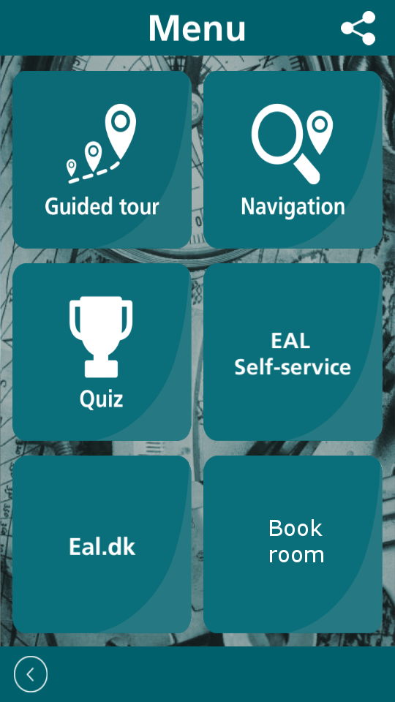
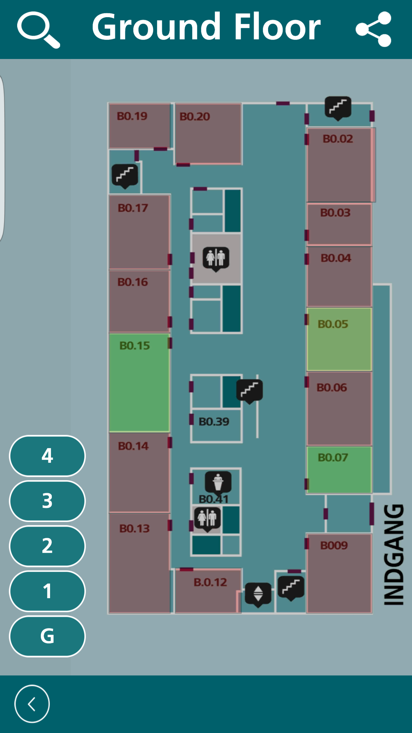
Mock Ups

Slide 8
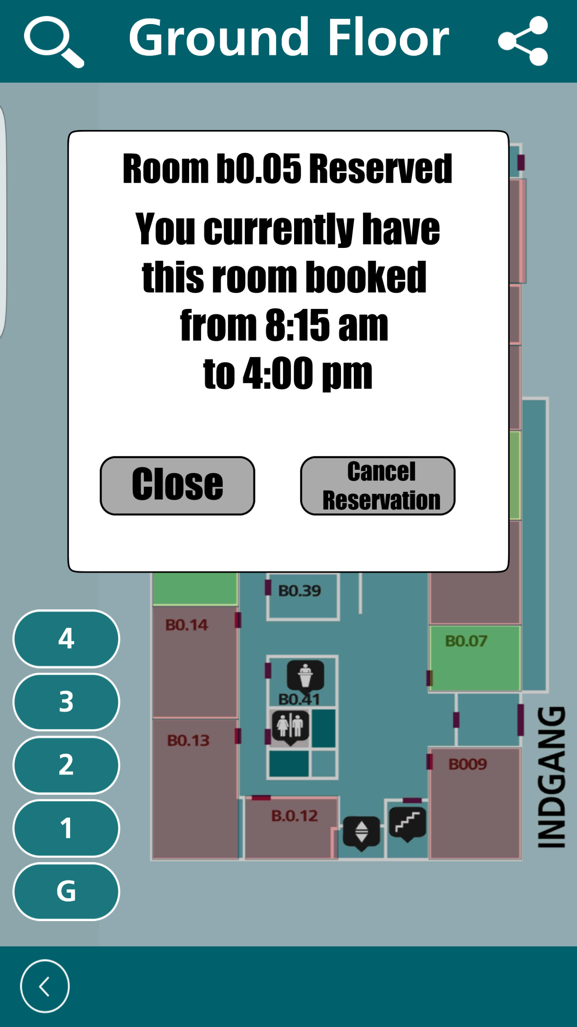
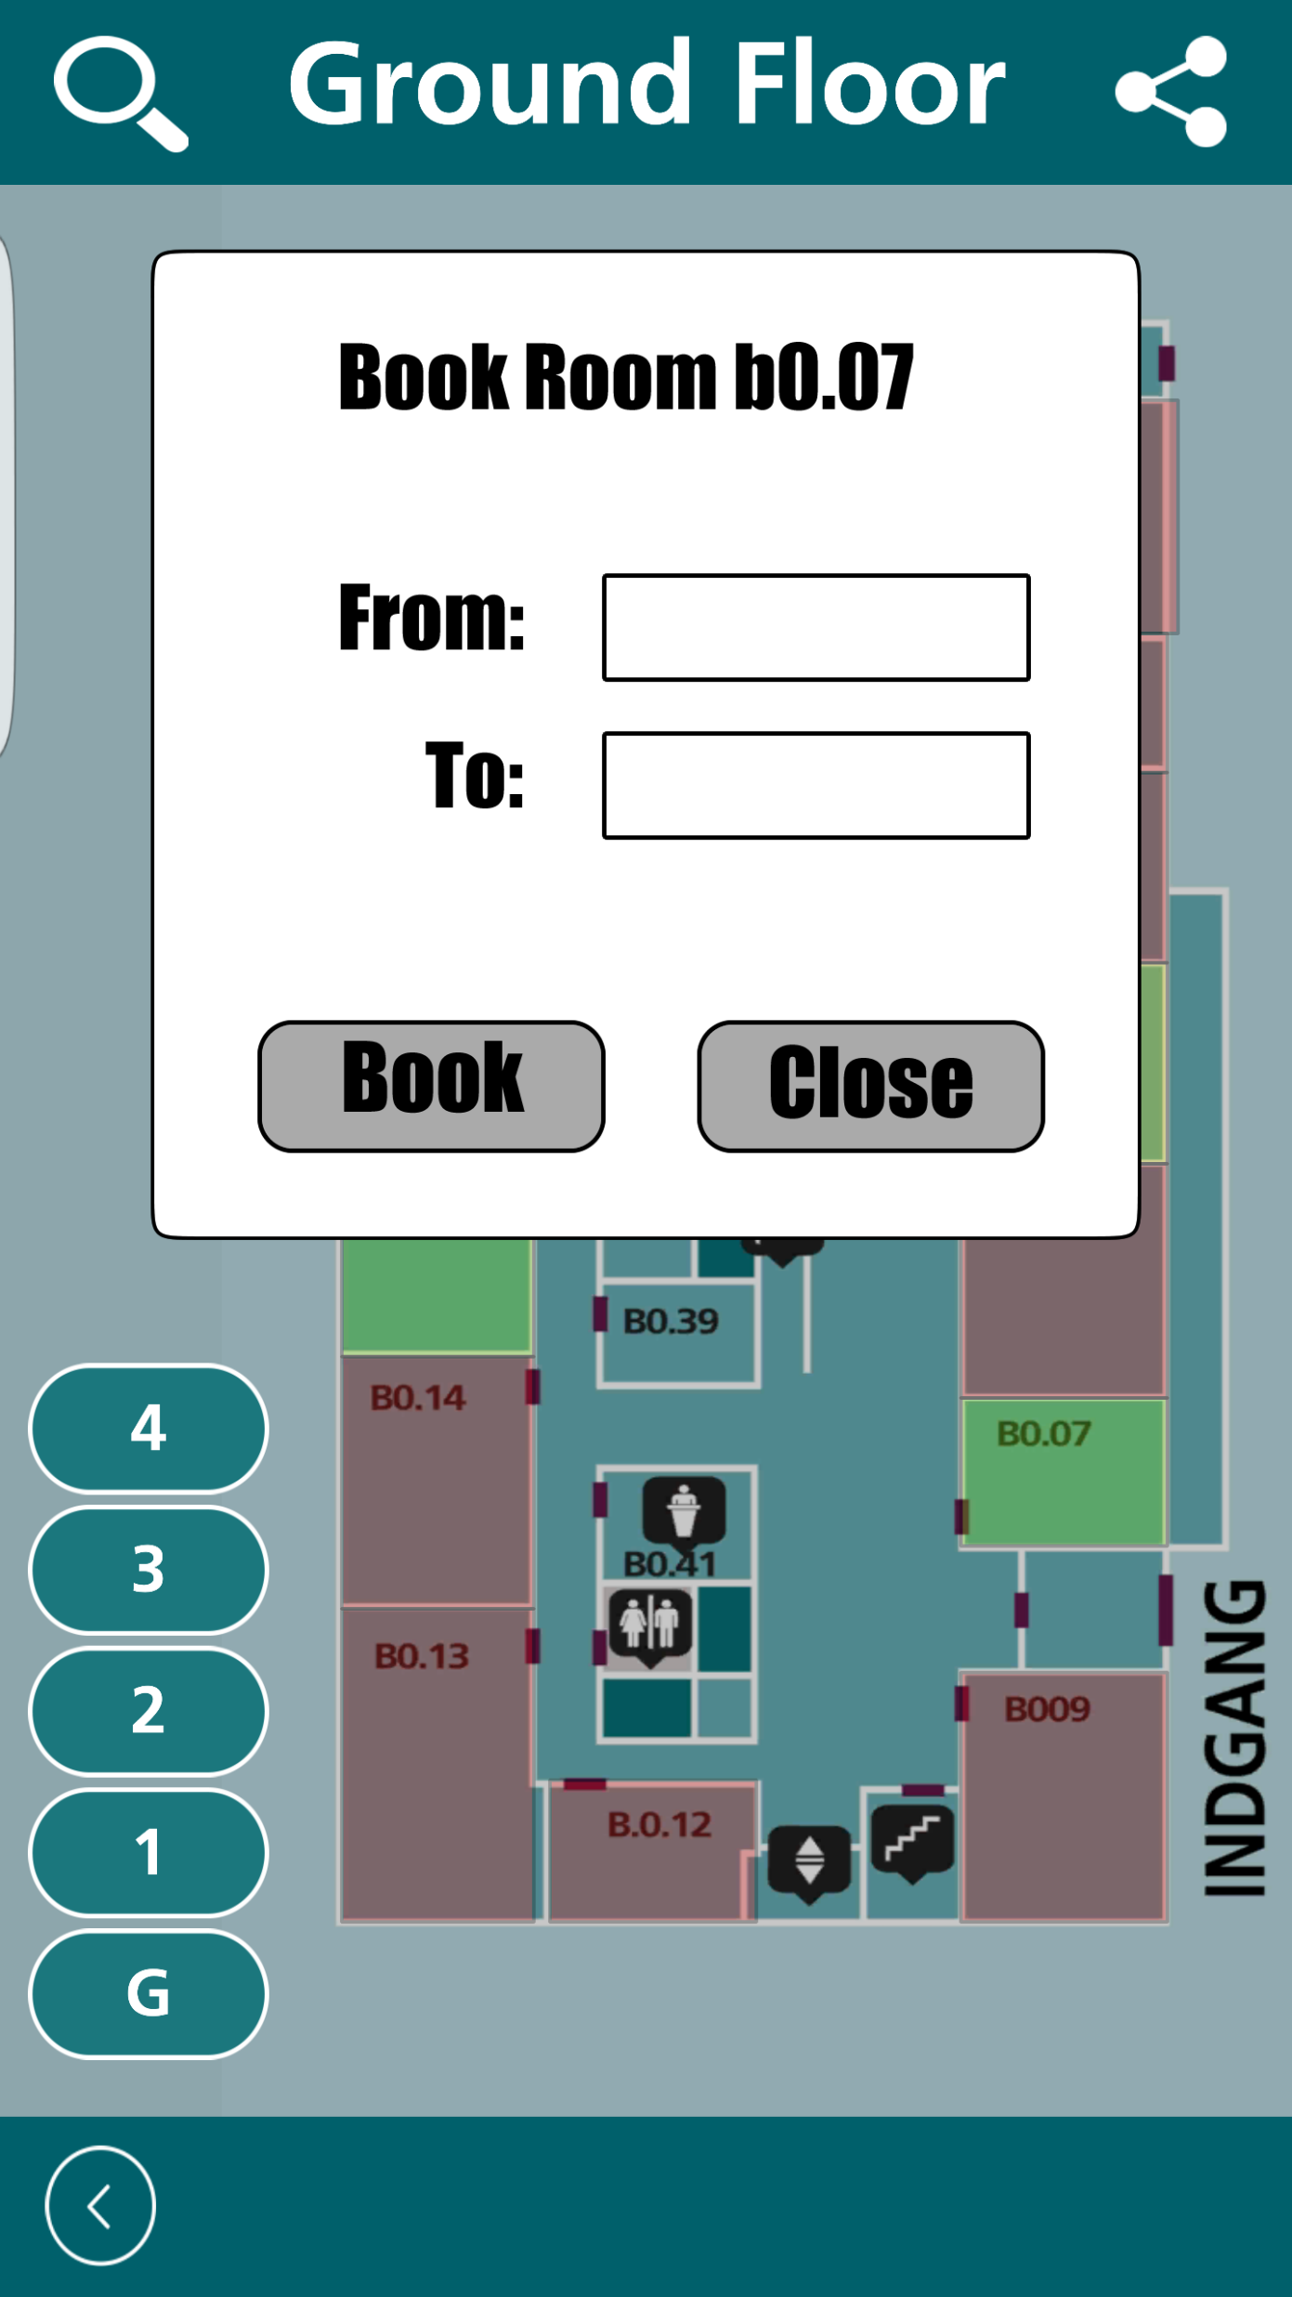
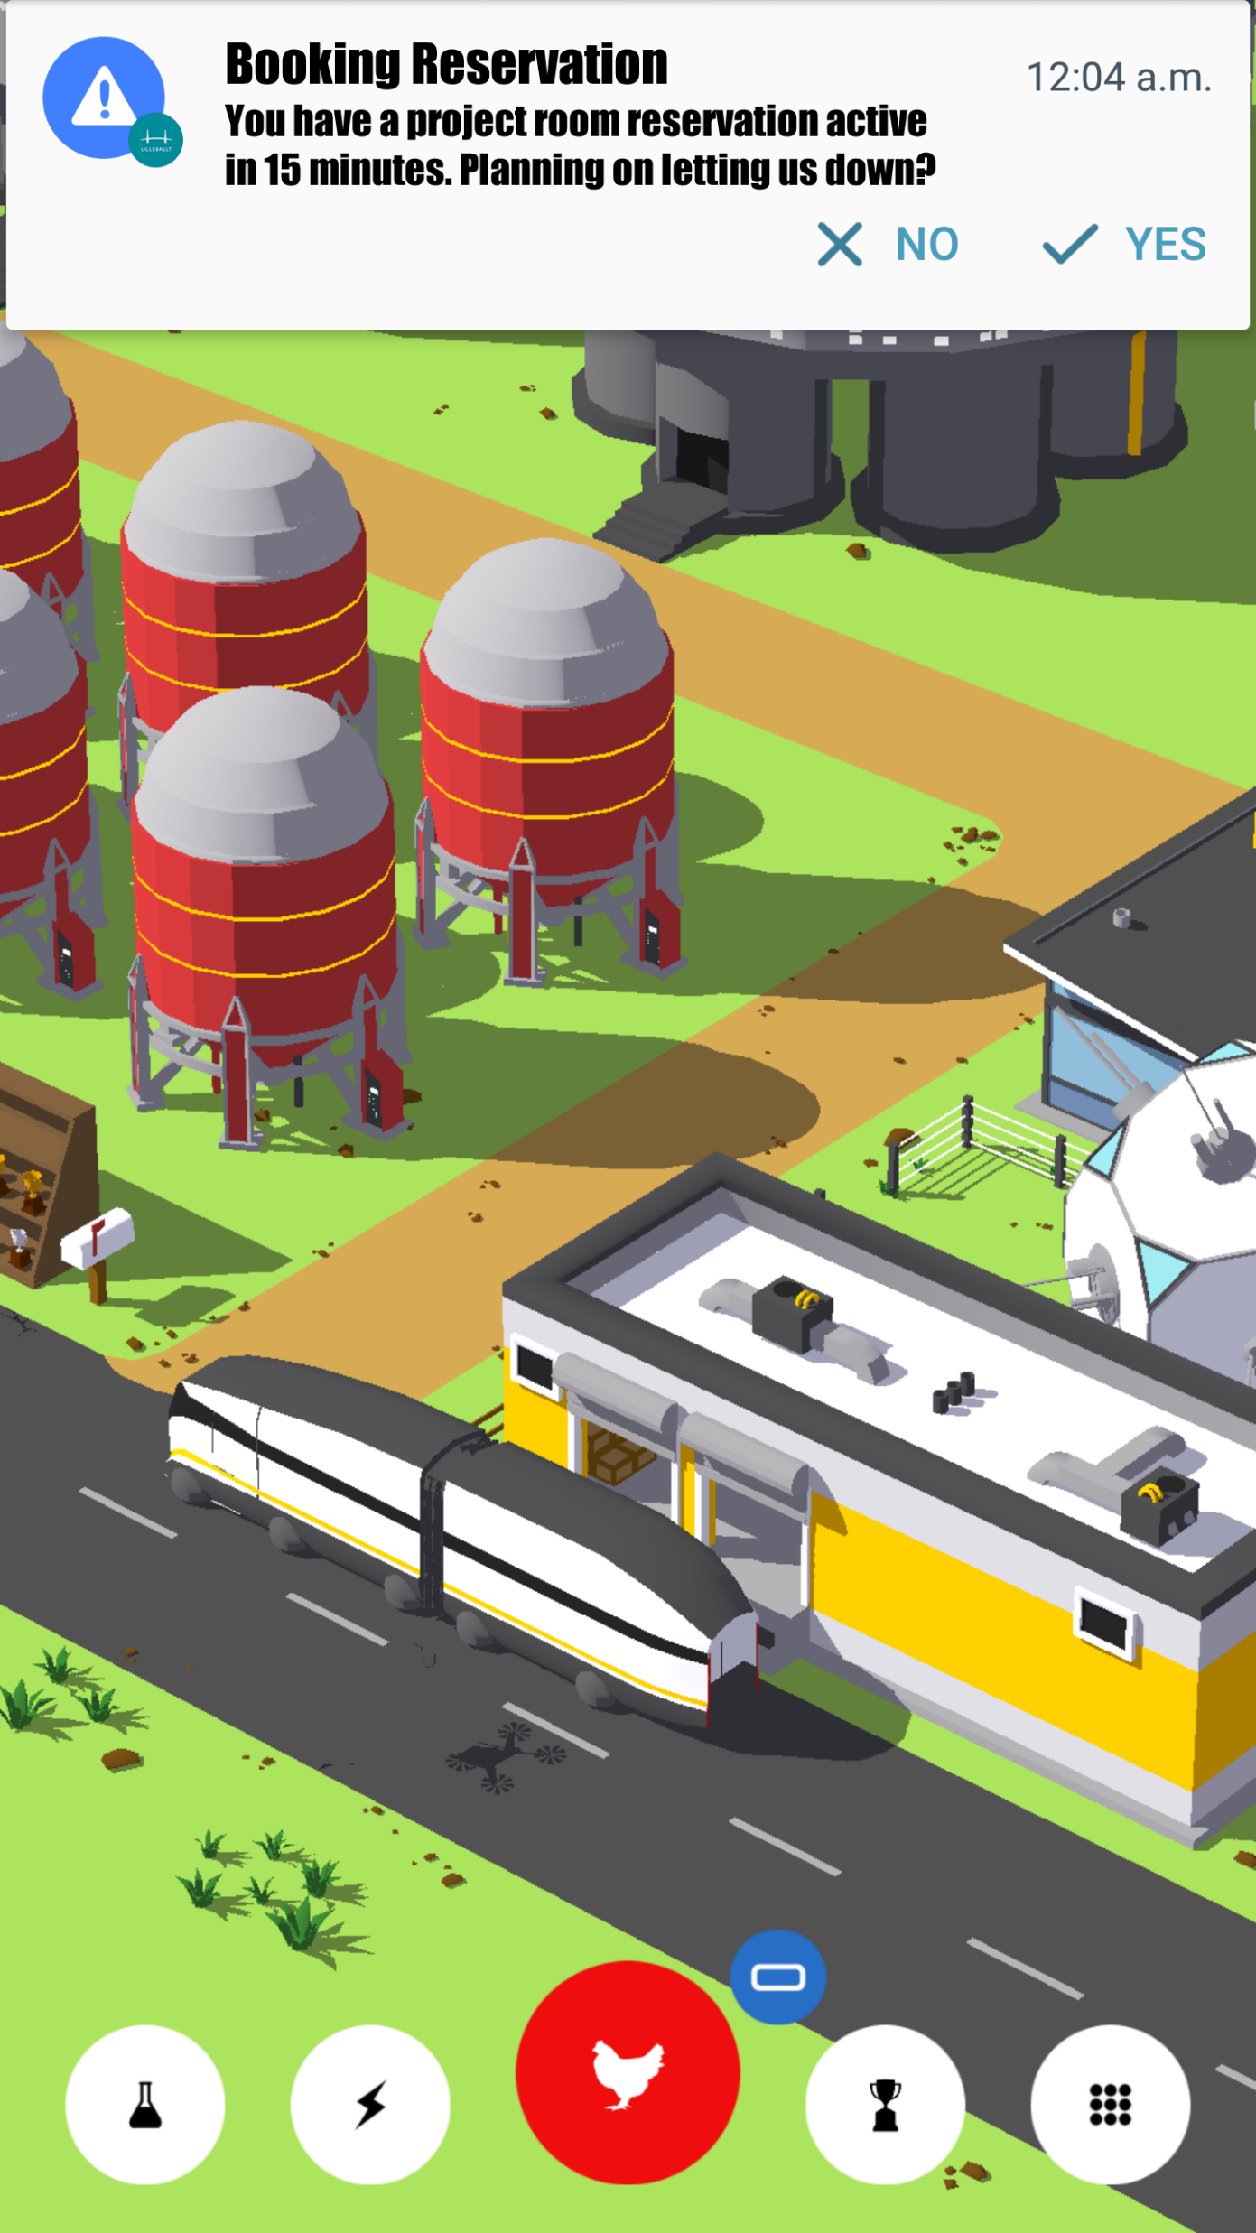
Mock Ups

Slide 9

Thank you for your time & Attention

